Slide 1
Fine Art and Photography
Induction 4th July 2019

Slide 2
Outline of the course
A linear course, which means you will take an exam in Year 13. Essentially a two year course.
A Level Year 1: Component 1: Personal Investigation. An extended project inspired by a topic requiring a substantial final response
A Level Year 2: Component 1: Personal Investigation and Component 2: Externally Set Assignment (15 hours final exam). A project inspired by a given topic leading to a final response under controlled environment

Slide 3
Outline of the course
A level Year 1
Component 1: Personal Investigation
No time limit
96 marks
60% of A-level
A level Year 2
Component 1: Personal Investigation
No time limit
96 marks
60% of A-level
Component 2: Externally Set Assignment
Preparatory period +15 hours controlled practical exam
96 marks
40% of A-level

Slide 4
Stationery Requirements
Set of hard and soft pencils.
Set of paints.
Mix of paintbrushes.
Box of pastels.
Rubber, ruler and sharpener.
USB device
A ‘good’ camera
Access to colour printing

Slide 5
Active activity!
Looking through past student portfolios
Identify a range of course/exam work
Explore themes and different responses
Develop understanding of AO’s and how they are linked to all outcomes
Discuss bridging work

Slide 6
Bridging work
Component 1: Personal Investigation
Isolation
Unexpected Perspectives
Sensory Experience
Messages
Select ONE of these topics and produce a body of work. This can the form of a sketchbook or loose studies; a collection of photographs inspired by others’ ideas
Submission:
Personal work relating to ONE topic
Responses presented on a USB device, print outs, sketchbook and/or on loose paper.
Hand in first lesson

Slide 7
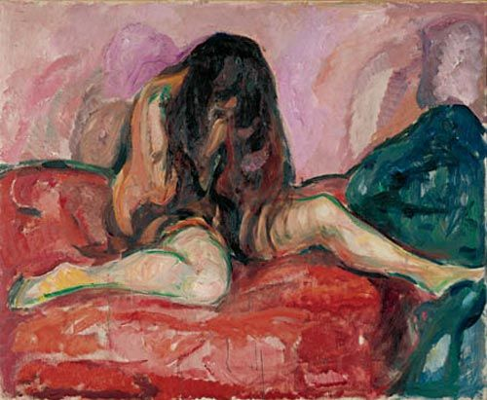
ISOLATION

Slide 8
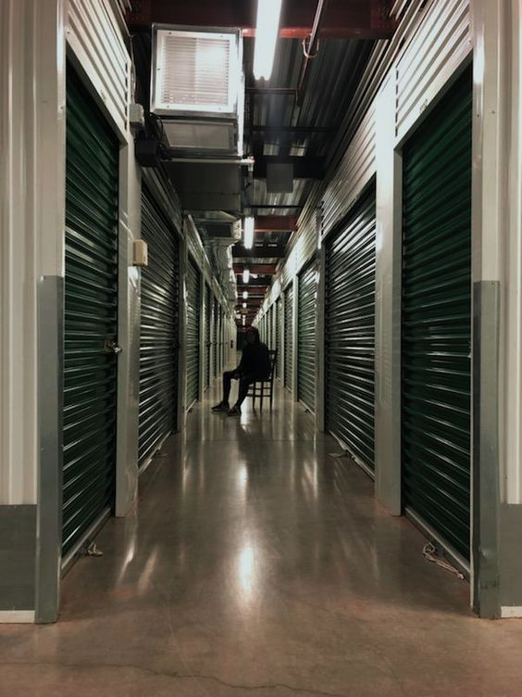
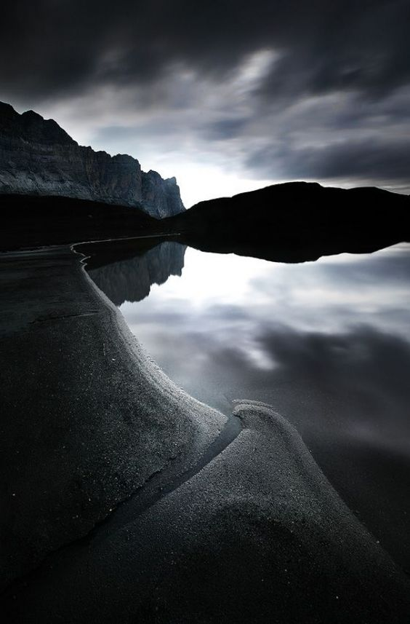

Slide 9
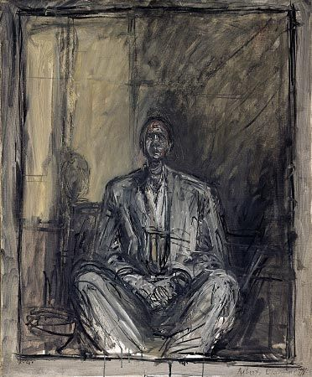
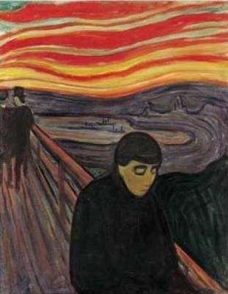
Alberto Giacometti
Edvard Munch

Slide 10
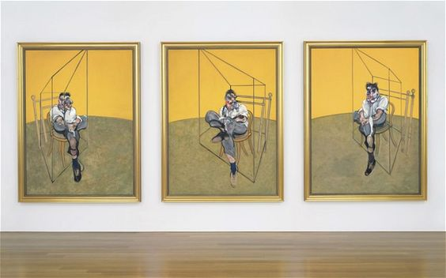
Francis Bacon

Slide 11
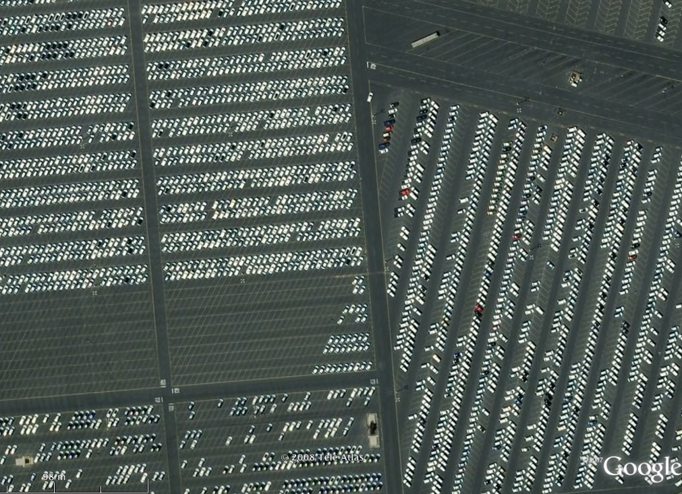
Unexpected Perspectives

Slide 12
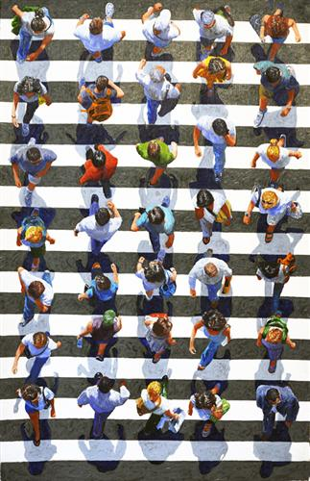
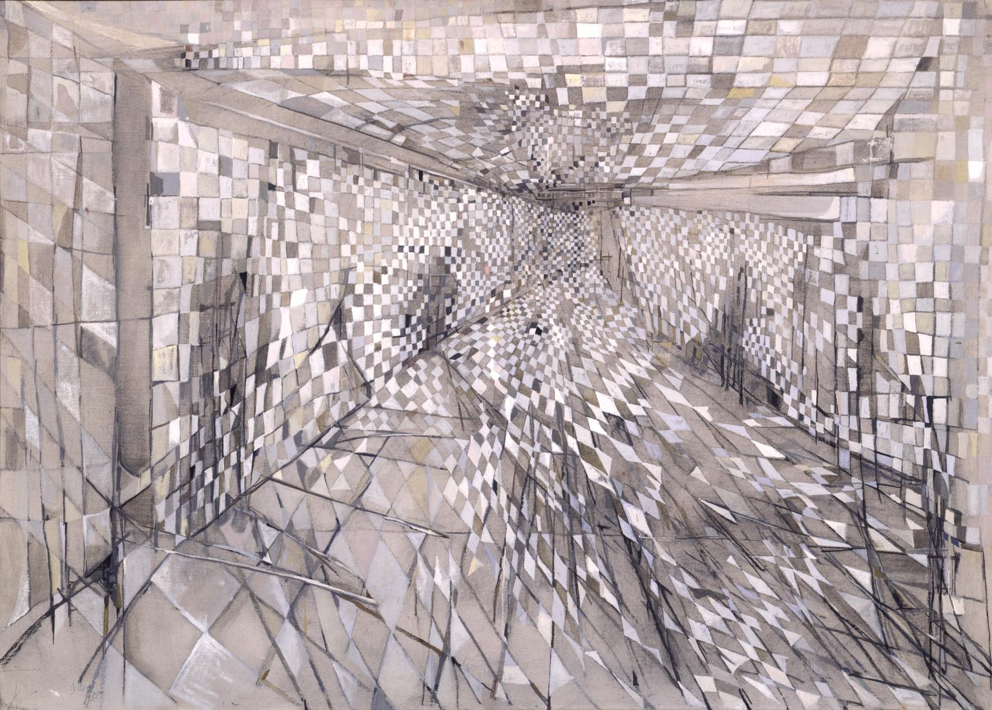
Maria Helena Vieira da Silva, The Corridor
Jim Zwadlo

Slide 13
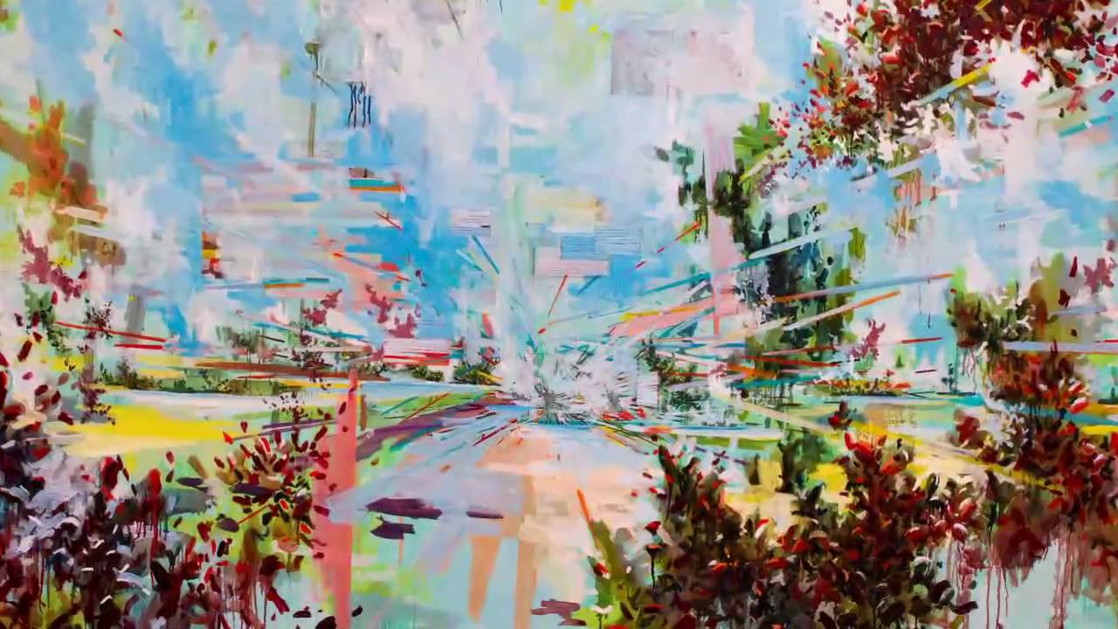
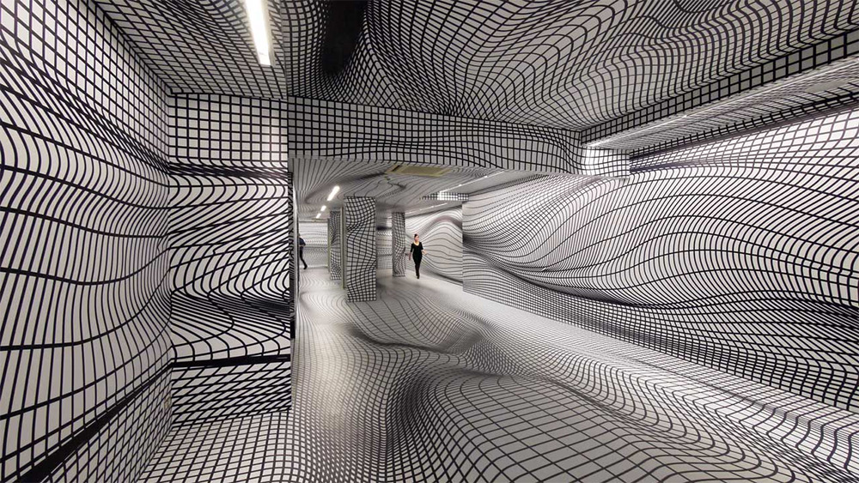
David Schnell
Peter Kogler

Slide 14
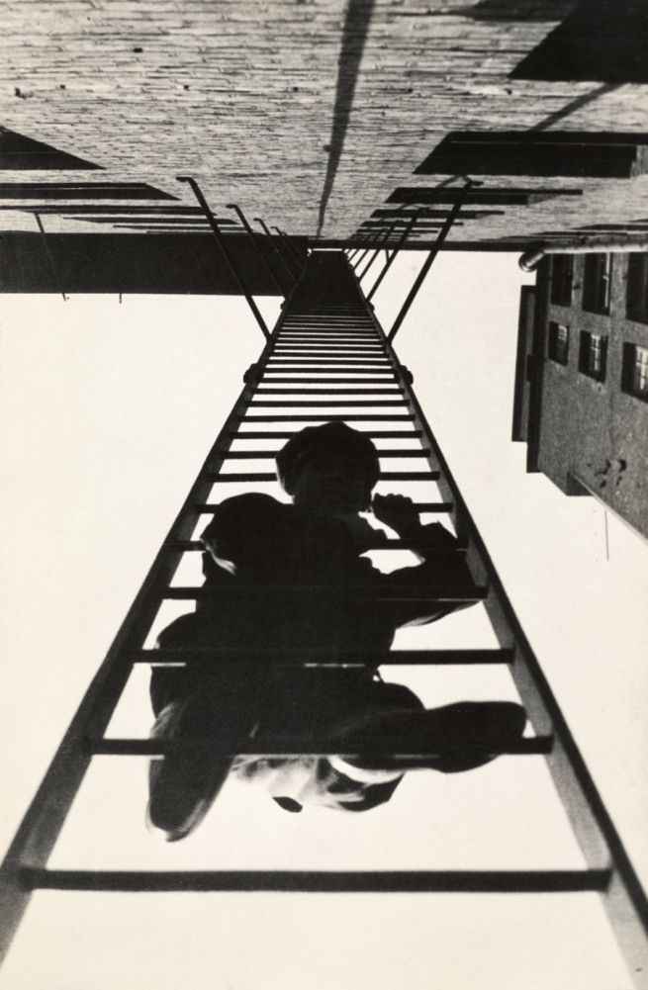
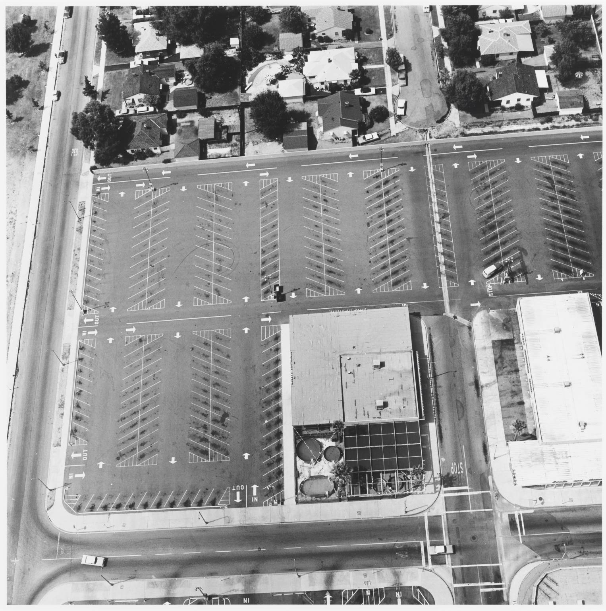
Ed Ruscha
Alexander Rodchenko

Slide 15
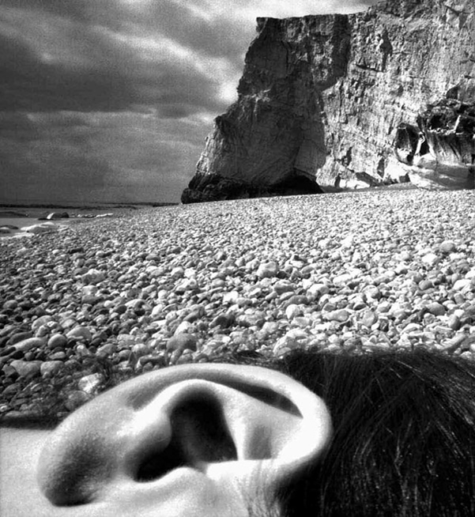
Bill Brandt

Slide 16
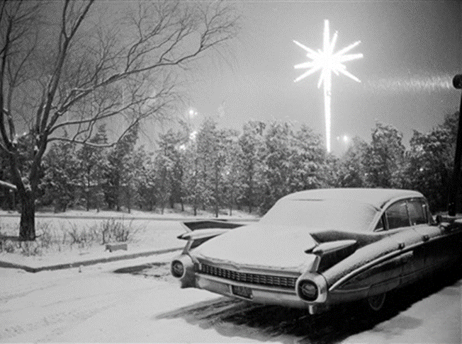
Sensory Experience

Slide 17
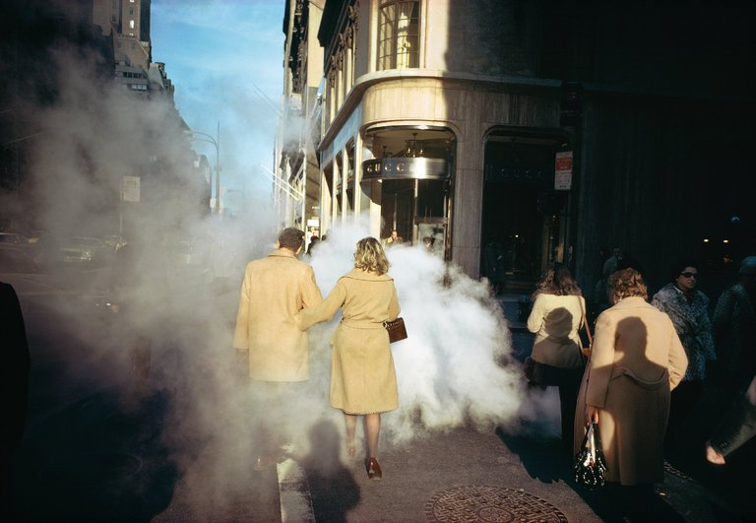
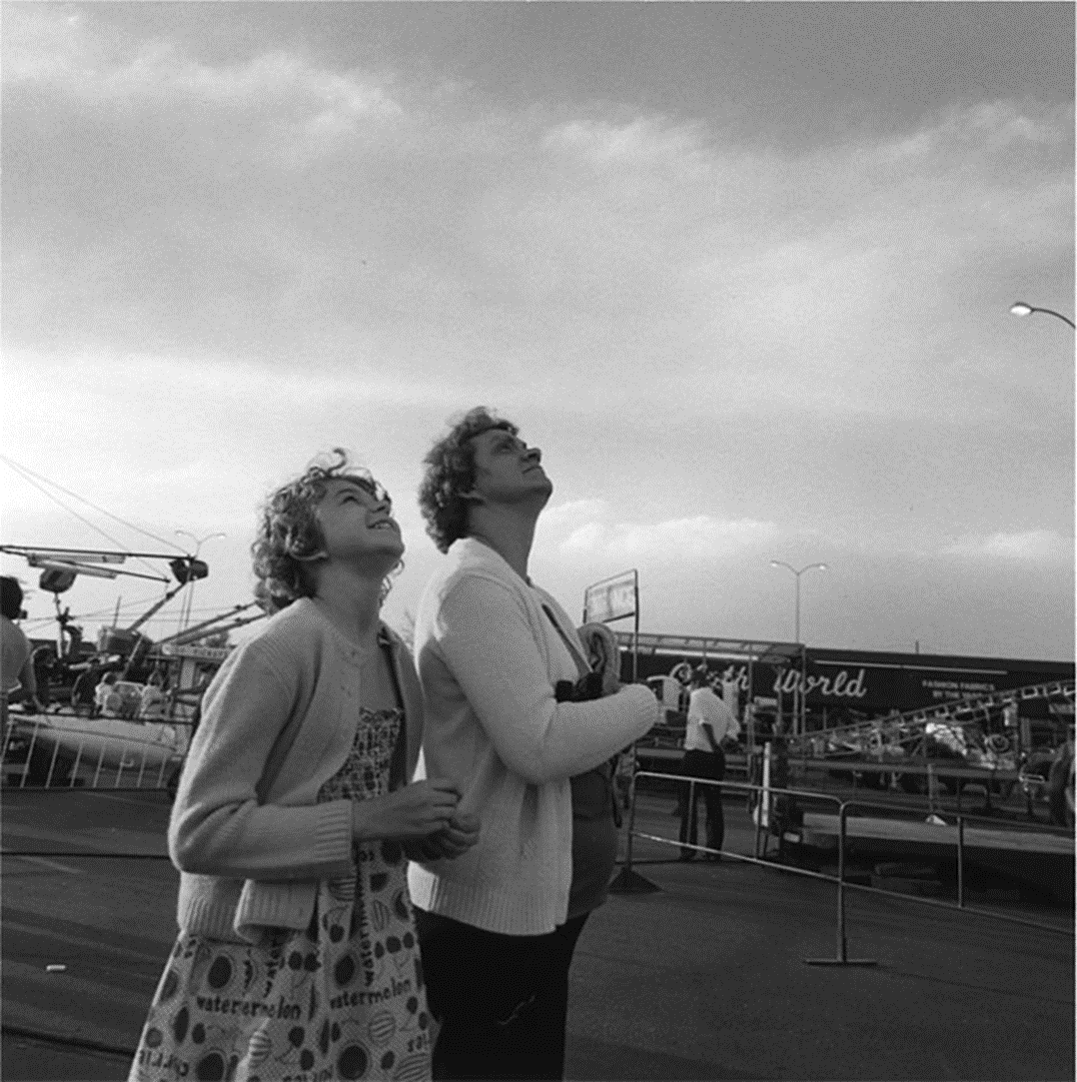
Joel Meyerowitz
Robert Adams

Slide 18
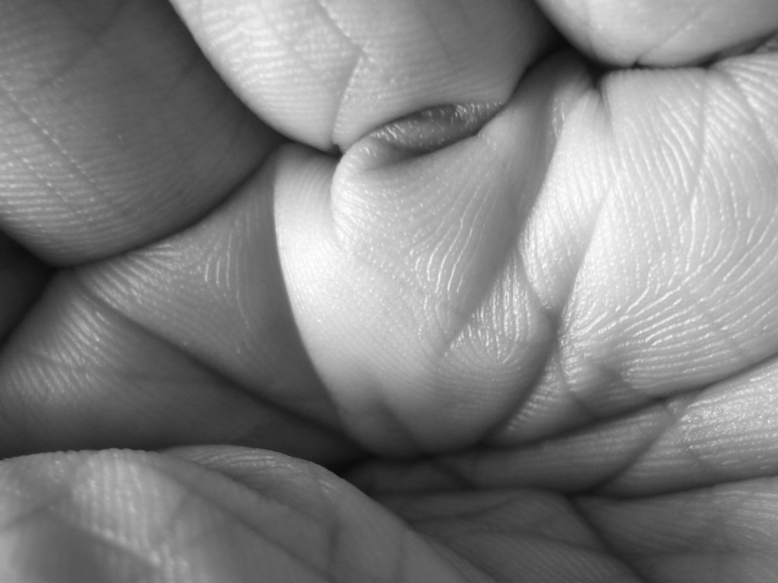

Slide 19
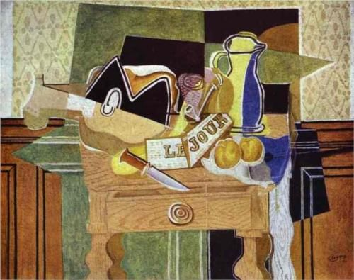
3-MESSAGES

Slide 20
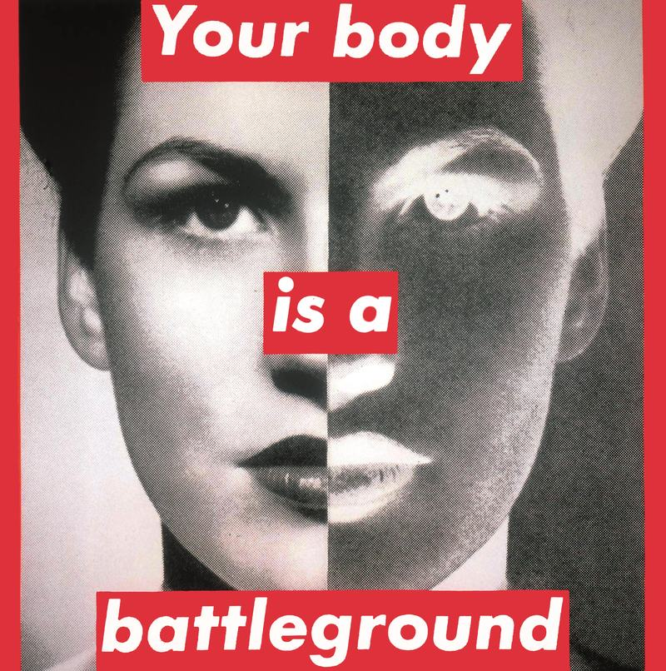
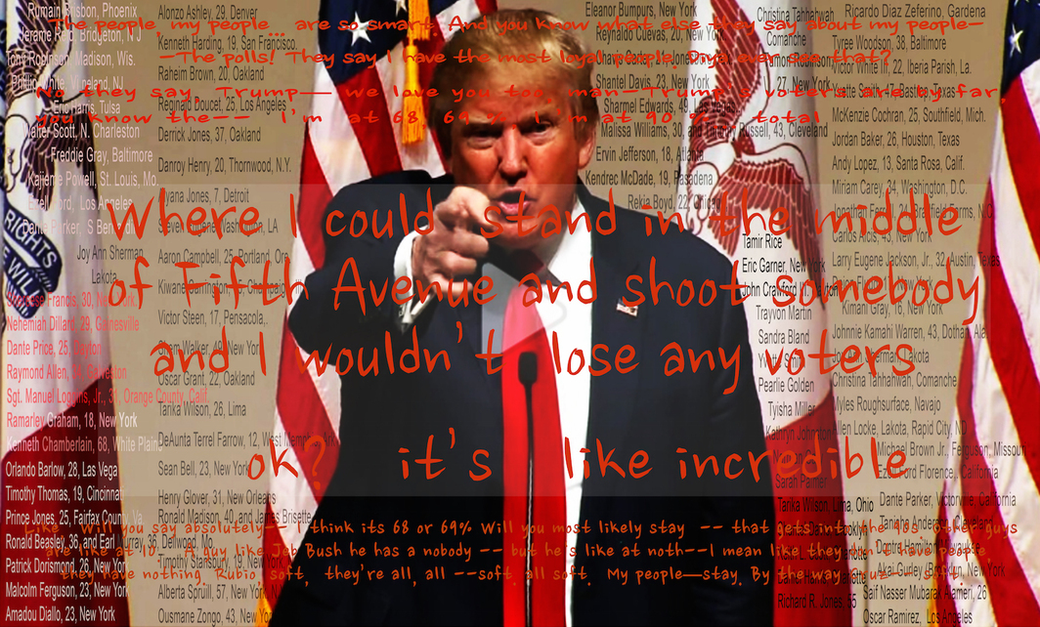
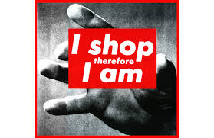
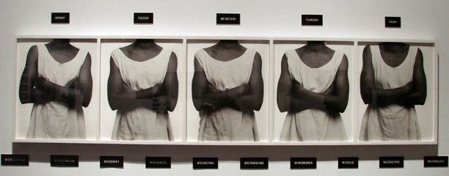
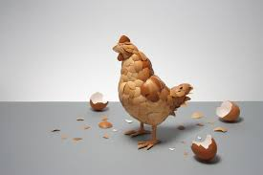
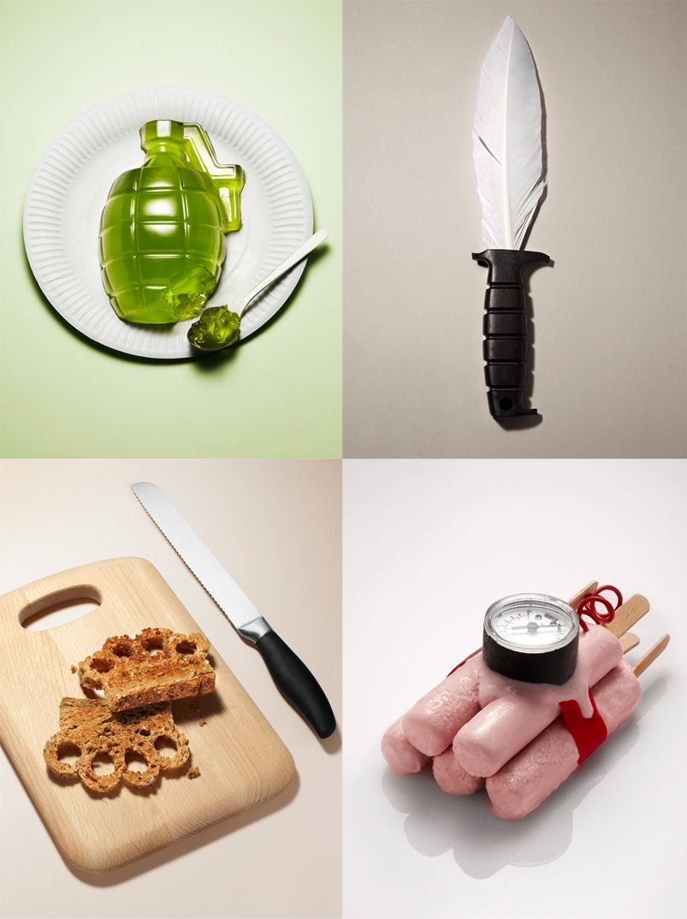
Messages
Barbara Kruger, Martha Rosler and Lorna Simpson combine words and phrases with their photographs to convey messages. In his animation ‘Awesome Stuff Week’, designer and illustrator Kyle Bean uses the stop frame process for a title sequence in a YouTube advertising campaign.
Study appropriate sources and produce your own work that conveys a message by combining words with photographs.

Slide 21
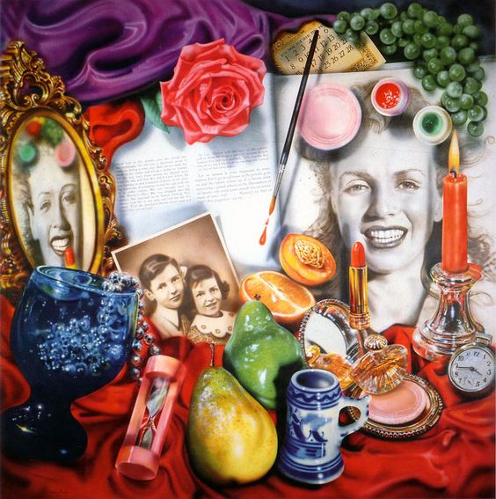
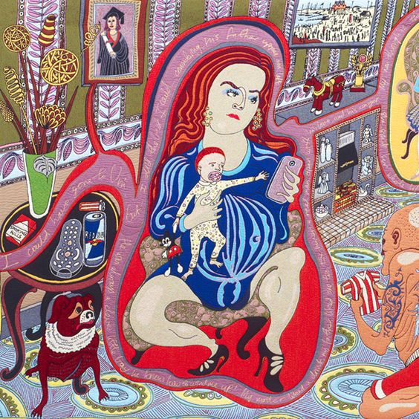
JOHN STEZAKER, COMEDY DISTORTION
Audrey Flack
Grayson Perry

Slide 22
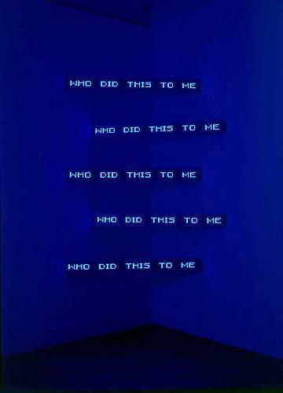
Jenny Holzer
Lizzie Stewart

Slide 23
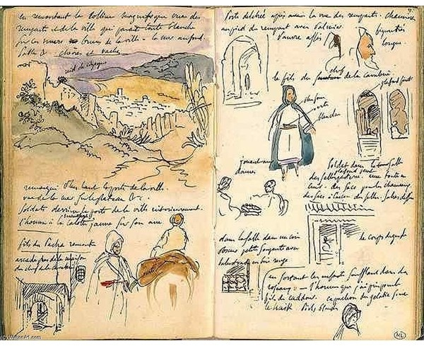
Delacroix

Slide 24
Final Tips
Ensure you purchase your equipment and resources before September
Give yourself enough time to complete your bridging work
Practice your basic skills over the summer, that way you won’t feel you are starting from ‘scratch’

