Slide 1
AQA A 'Level Economics
Induction

Slide 2
Why Economics?
A-level Economics helps students:
develop an interest and enthusiasm for economics and its contribution to the wider political and social environment
develop an understanding of a range of concepts and acquire an ability to use these concepts in a variety of different contexts
develop an enquiring, critical and thoughtful 'economist's mind'
practice skills, qualities and attitudes which will equip them for the challenges, opportunities and responsibilities of adult and working life
develop an understanding of current economic issues, problems and institutions that affect everyday life
apply economic concepts and theories in a range of contexts and appreciate their value and limitations in explaining real world phenomena
analyse, explain and evaluate the strengths and weaknesses of the market economy and the role of government within it.

Slide 3
Outline of the Course
No coursework or controlled assessments
You need not have studies Economics before
You will have 3 two hour exams in Year 13 – the course is hard – it is challenging and rewarding but requires commitment

Slide 4
Outline of the course
In Year 2, you will complete 3 final examinations each worth 33.33% of your final grade. Economics is essentially a two year course.
AS: Two 1:30 hour examinations with a combination of multiple choice, data, medium and essay based questions – this will be sat in school.
A2: Three 2 hour examinations each with a combination of multiple-choice, data, medium and essay based questions. Paper three is a case study requiring you to use knowledge from the entire course

Slide 5
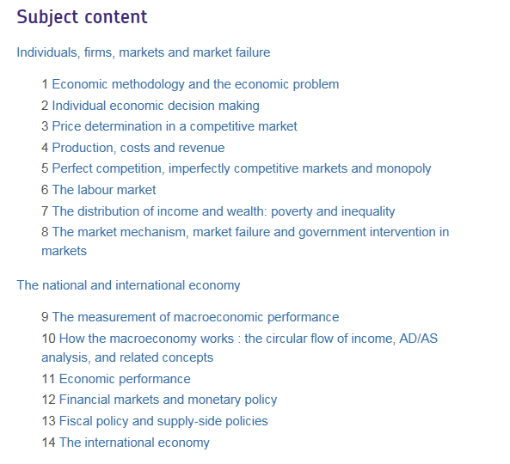
Subject Content

Slide 6
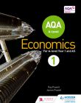
Stationery Requirements
Two large folders (lever arch not ring bound)
Pens
Calculator
Ruler
Stapler
AQA Economics Student Book 1
Authors: Ray Powell and James Powell Publisher: Hodder Education ISBN-13: 978-14718-2978-9 Price: £24.99

Slide 7
Activity
Economics examines the impact of events or actions on individuals, groups and the economy as a whole
The level of obesity and sedentary lifestyles are both increasing in the UK
Group Work
Get into groups of 4, each group will have to answer one allocated question. All groups can attempt the challenge question!
Describe the consequences of this for the individual
Describe the consequences of this for wider society
Describe the consequences of this for the economy
Challenge – What could the government do to improve this situation. What are the pros and cons of these policies?
Write your points on the sugar paper provided and be ready to feedback!

Slide 8
Final Tips
Ensure you purchase your stationery before arriving in September, (2 x lever arch files, dividers, stapler, calculator)
File notes after EVERY lesson
Read ahead – we will tell you what chapter to read in advance

Slide 9
Summer Bridging Activity

