Slide 1
English Literature
Induction, 4th July 2019

Slide 2
A Level Literature: Outline of the Course
You will study a range of texts that are grouped under the headings of:
Aspects of Tragedy (three texts)
Elements of Political and Social Protest Writing (three texts)
There is also a Non – Examined Assessment (Coursework) of two essays.
Across a two year course you will be studying at least 8 texts:
6 of which are for examination and are set
2 are for independent study and will be your choice (within reason!)
You will also have secondary reading that is needed for the study of texts, including your reading of ‘The Critical Anthology’.
You will have 2 exams at the end of year 13… and mocks throughout the two years.

Slide 3
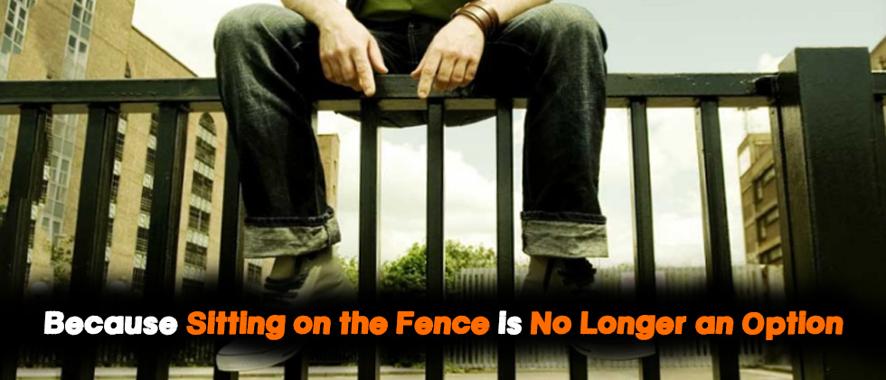
A Level Literature: FIND YOUR VOICE
You should show creativity in your thinking…
Fresh viewpoints!
WHAT IS YOUR STANCE ON AN ISSUE?
Intellectually creative- personality in your writing

Slide 4
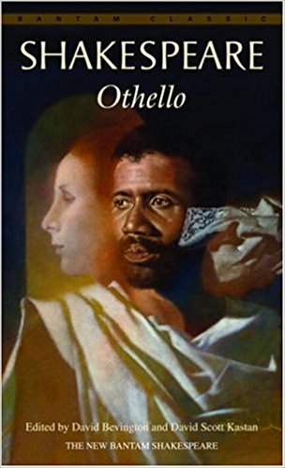
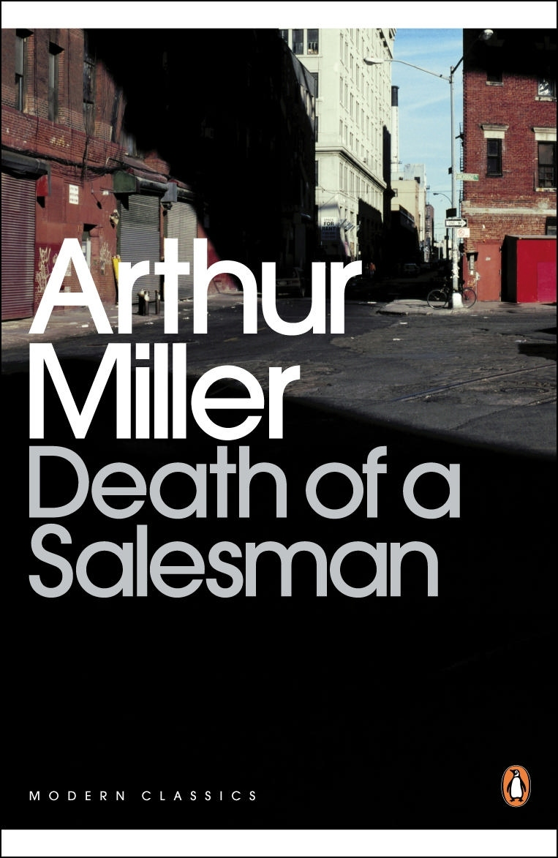
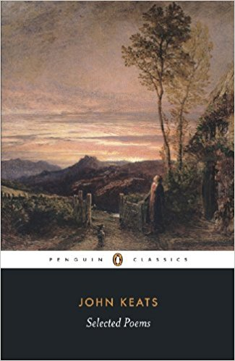
Aspects of Tragedy
‘Othello’ by William Shakespeare
‘Death of a Salesman’ by Arthur Miller
Poetry of John Keats
You will sit one examination paper which is 2 hours and 30 minutes. This paper accounts for 40% of your A-Level grade.
Closed Book!

Slide 5
The Study of Tragedy
At the core of all the set texts is a tragic hero or heroine who is flawed in some way, who suffers and causes suffering to others and in all texts there is an interplay between what might be seen as villains and victims. Some tragic features will be more in evidence in some texts than in others and students will need to understand how particular aspects of the tragic genre are used and how they work in the four chosen texts. The absence of an ‘aspect’ can be as significant as its presence. There can be no exhaustive list of the ‘aspects’ of tragedy but areas that can usefully be explored include:
• the settings for the tragedy, both places and times
• the journey towards death of the protagonists, their flaws, pride and folly, their blindness and insight, their discovery and learning, their being a mix of good and evil
• the role of the tragic villain or opponent, who directly affects the fortune of the hero, who engages in a contest of power and is partly responsible for the hero’s demise
• the presence of fate, how the hero’s end is inevitable
• how the behaviour of the hero affects the world around him, creating chaos and affecting the lives of others
• the significance of violence and revenge, humour and moments of happiness
• the structural pattern of the text as it moves through complication to catastrophe, from order to disorder, through climax to resolution, from the prosperity and happiness of the hero to the tragic end
• the use of plots and sub-plots
• the way that language is used to heighten the tragedy
• ultimately how the tragedy affects the audience, acting as a commentary on the real world, moving the audience through pity and fear to an understanding of the human condition.

Slide 6
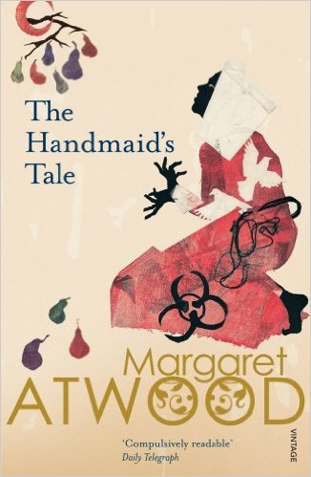
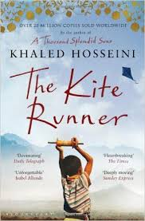
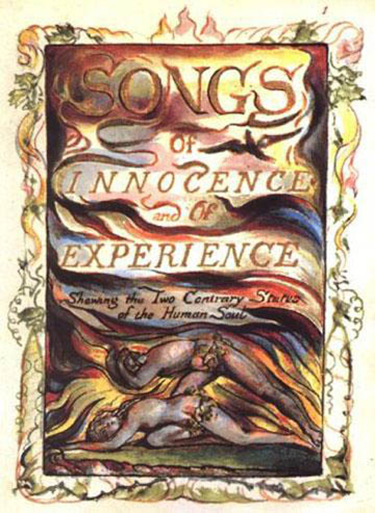
Elements of Political and Social Protest Writing
The Poetry of William Blake
‘Handmaid’s Tale’ by Margaret Atwood
‘The Kite Runner’ by Khaled Hosseini
You will sit 1 examination paper at the end of the course; which is 3 hours in length (40% of A Level Grade).
Open Book!

Slide 7
Elements of Political and Social Protest Writing
Although it could be claimed that all texts are political, what defines the texts here is that they have issues of power and powerlessness at their core, with political and social protest issues central to each text’s structure. The political and social protest genre covers representations of both public and private settings. All set texts foreground oppression and domination and they all look at the cultures we live in and have lived in over time.
A crucial word in the title of this option is ‘Elements’ and students need to consider the specific elements that exist in each of their texts. The elements that might be explored, depending on each individual text, include:
• the type of the text itself, whether it is a post-modern novel, science fiction, satirical poetry, historical and political drama
• the settings that are created as backdrops for political and social action and the power struggles that are played out on them. Both places (real and imagined) and time settings will also be significant here
• the specific nature of the power struggle, the behaviours of those with power and those without, those who have their hands on the levers of power
• the pursuit of power itself, rebellion against those with power, warfare
• the workings of the ruling political classes
• corruption, conspiracy, control
• the connection of the smaller world to the larger world
• the focus on human organisation: domestically, in the work place, in local and national governments
• gender politics and issues of social class
• the structural patterning of the text, how political tensions are heightened and perhaps resolved
• the way that language is used in the worlds that are created

Slide 8
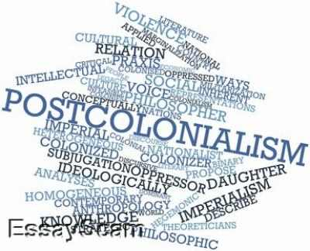
A Level Study – Non exam assessment- Theory and Independence
You will be writing two essays, one about a prose text and the other about a poetry text. These essays will be informed by the reading of a ‘Critical Anthology’.
Each essay has a word count limit of 1250 – 1500 words.
Students each write on different texts (selected by the students with guidance of teacher) and each student crafts their own essay questions which are linked to theories in the ‘Critical Anthology’.

Slide 9
Theory and Independence
This unit of study is designed to allow you to read and to choose your own texts (if appropriate) and to understand that contemporary study of literature needs to be informed by the fact that different theoretical and critical methods can be applied to the subject. As such you will be encouraged to read texts through particular ‘lenses’.
The title ‘Theory and independence’ highlights the important idea that, within a literature course, you should have the opportunity to work as independently as possible.
The AQA Critical anthology introduces you to ways of critically engaging with texts:
narrative theory
feminist theory
Marxist theory
eco-critical theory
post-colonial theory
literary value and the canon.

Slide 10
Stationery Requirements
You will need to purchase a lever arch file and at least 10 dividers (these can be picked up really cheaply from places like ‘The Works’)
You will also need A4 hole punched paper which can be put into a file
Pens (black/blue/red)
You must bring whatever text you are studying to lessons

Slide 11
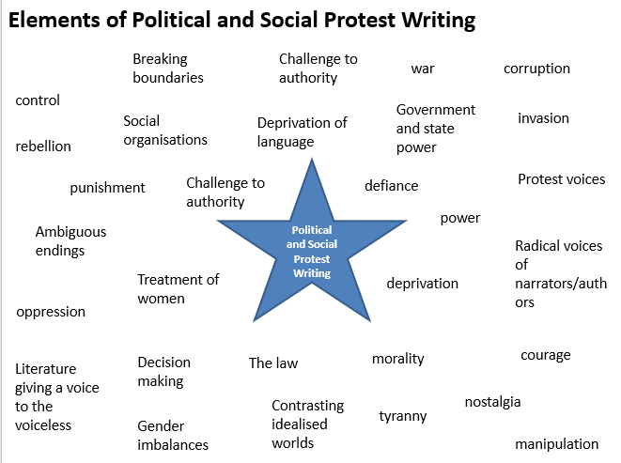
Unseen Social and Political Protest Learning Activity
1. Look at the list you’ve been given of elements of political and social protest writing. This list is not exhaustive.
Can you create any sub-groups?
Which lend themselves to each other?
CHALLENGE: Can you apply any of these elements to texts you have read yourself?

Slide 12
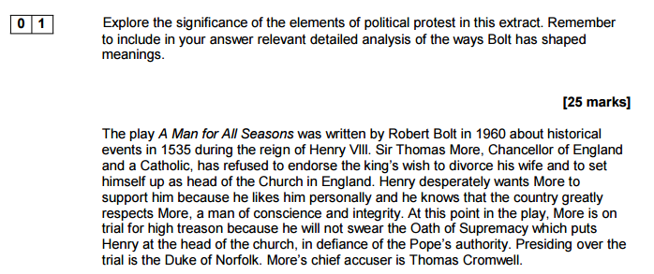
Unseen Social and Political Protest Learning Activity
2. Look at the unseen text you’ve been given…
a. Read the pre-amble: Just having read this, which elements of political and social protest writing can you see emerging?
b. Read the rest of the extract- highlight and annotate, looking for aspects of political and social protest literature emerging.
http://filestore.aqa.org.uk/resources/english/AQA-77172B-SQP.PDF

Slide 13
Bridging work
Read:
‘Othello’,
‘Death of a Salesman’
‘Songs of Innocence and Experience’
‘Handmaid’s Tale’

Slide 14
To be a student of English.....
You must be reading the texts independently, and rereading texts – they need to become your best friends. You should be carrying the text with all the time, reading at every opportunity.
You should be reading about literature through reviews and essays (The Guardian; The London Literary Review?)

Slide 15
Resources

Slide 16
Elements of Political and Social Protest Writing
Breaking boundaries
Challenge to authority
war
corruption
control
Government and state power
invasion
Social organisations
Deprivation of language
rebellion
Political and Social Protest Writing
Protest voices
punishment
Challenge to authority
defiance
power
Ambiguous endings
Radical voices of narrators/ authors
Treatment of women
deprivation
oppression
Decision making
The law
morality
courage
Literature giving a voice to the voiceless
Contrasting idealised worlds
nostalgia
tyranny
Gender imbalances
manipulation

