Slide 1
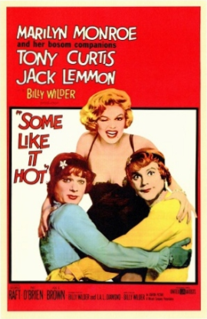
A Level Film Studies
Induction – 4th July 2019

Slide 2
Outline of the course
Linear – 2 year course… 70% exam, 30% NEA
Component 1: Varieties of film and filmmaking
Written examination: 2½ hours, 35% of qualification
This component assesses knowledge and understanding of six feature-length films.
Section A: Hollywood 1930-1990 (comparative study). One question from a choice of two, requiring reference to two Hollywood films, one from the Classical Hollywood period (1930-1960) and the other from the New Hollywood period (1961-1990).
Section B: American film since 2005 (two-film study). One question from a choice of two, requiring reference to two American films, one mainstream film and one contemporary independent film.
Section C: British film since 1995 (two-film study). One question from a choice of two, requiring reference to two British films.

Slide 3
Outline of the course
Linear – 2 year course… 70% exam, 30% NEA
Component 2: Global filmmaking perspectives
Written examination: 2½ hours, 35% of qualification
This component assesses knowledge and understanding of five feature-length films (or their equivalent).
Section A: Global film (two-film study). One question from a choice of two, requiring reference to two global films: one European and one produced outside Europe.
Section B: Documentary film. One question from a choice of two, requiring reference to one documentary film.
Section C: Film movements – Silent cinema. One question from a choice of two, requiring reference to one silent film or group of films.
Section D: Film movements – Experimental film (1960-2000). One question from a choice of two, requiring reference to one film option.

Slide 4
Outline of the course
Linear – 2 year course… 70% exam, 30% NEA
Component 3: Production - Non-exam assessment
30% of qualification
This component assesses one production and its evaluative analysis. Learners produce:
either a short film (4-5 minutes)
or a screenplay for a short film (1600-1800 words) plus a digitally photographed storyboard of a key section from the screenplay
an evaluative analysis (1600 - 1800 words)

Slide 5
Stationery Requirements
You will need to purchase a lever arch file and at least 10 dividers (these can be picked up really cheaply from places like ‘The Works’)
You will also need A4 hole punched paper which can be put into a file
For coursework tasks, you’ll need access to a camera (though most smart phones now have good enough cameras)
Pens (black/blue/red) and highlighters

Slide 6
How is what we read in a film text influenced by the world around us?
TASK 1: Watch the clip. In pairs, consider the mood of the film. What are the audience encouraged to feel? How are they encouraged to feel this way?
TASK 2: The film, Eternal Sunshine of the Spotless Mind, is an independent film made in the US in 2004. What major event happened in the US shortly before this?
How might ESotSM reflect the attitude of the US post 9/11?
What have you learnt about how we decode images?
ENCODE: The meaning put into a media text (how producers try to make audiences think or feel a certain way)
DECODE: The meaning taken from a text by the audience, which is dependent on our experiences, media and the wider world around us

Slide 7
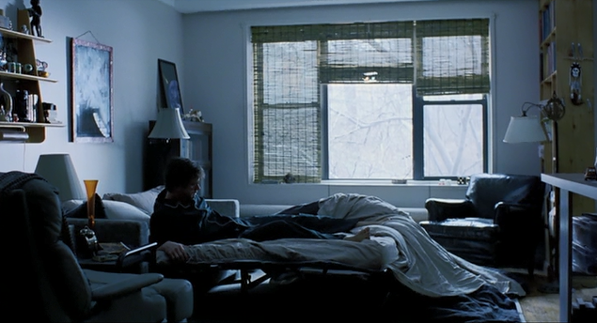

Slide 8
Bridging work – Film Studies
Over summer, you should choose a 2 minute sequence from one film of your choice (any genre) and analyse the mise-en-scene (everything in the frame). Use the sheet to help you if you’re unsure on key terms.
You need to consider the impact/effect of this e.g. The lighting is high key which suggests a positive atmosphere and comfortable relationship between the family
In September, you will present these film clips to the class with your analysis.
You must be able to supply this clip, so it could be on YouTube, DVD, Netflix etc, but you are responsible for ensuring you have it available to watch in class

Slide 9
Final Tips
Ensure you purchase your stationery before arriving in September, (lever arch files, dividers, lined and hole punched A4 pad, pens, calculator) – put the Film Studies terms sheet I have given you in this so that it’s there as a guide at all times.
File notes after EVERY lesson
Complete all reading asked of you – we will tell you what to read in advance

