Slide 1
Geography
Induction, 4th July 2019

Slide 2
A-Level GCE Geography

Slide 3
A-Level GCE Geography

Slide 4
A-Level GCE Geography

Slide 5
Walton-On-The Naze

Slide 6
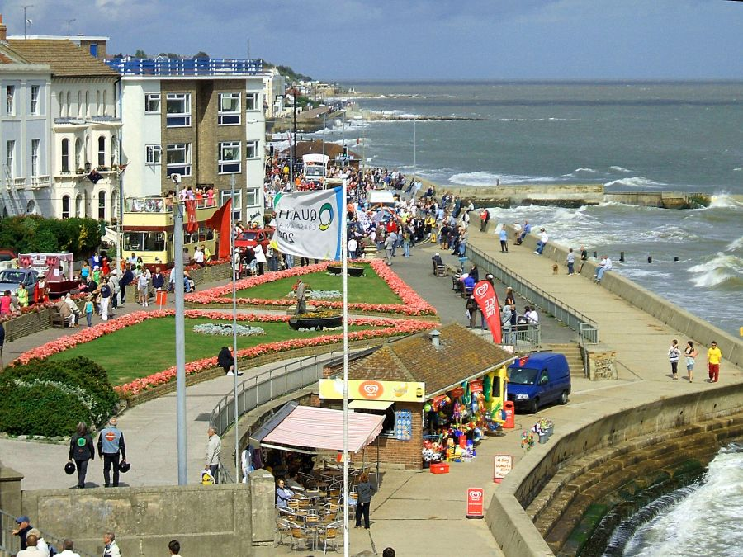
Walton-On-The Naze

Slide 7
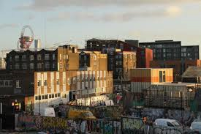
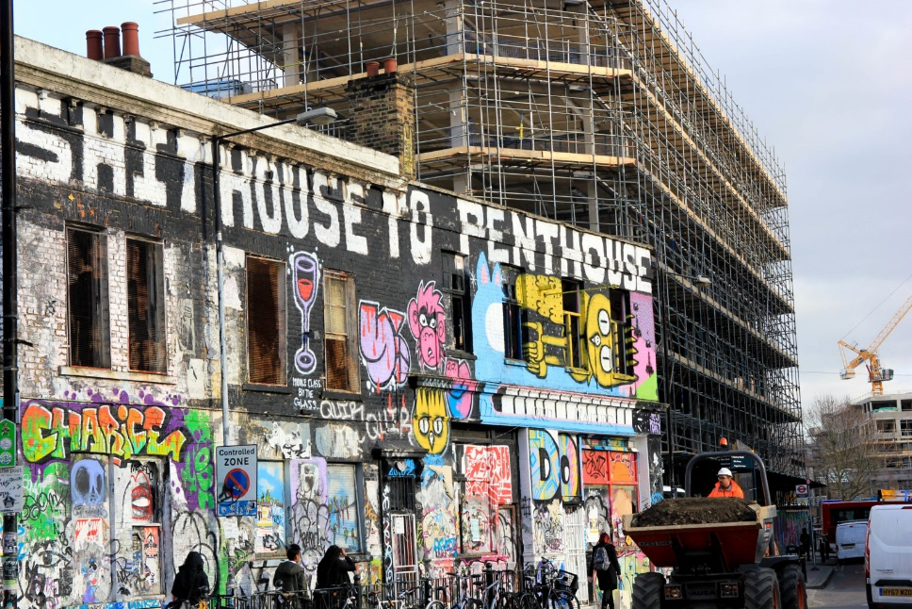
Stratford

Slide 8
Stationery Requirements
Two large folders (lever arch not ring bound)
Pens
Calculator
Ruler
Textbooks
AQA GCE Geography Textbook –
Different ones available for human/physical/combined Oxford / Hodder / Cambridge
Geography An Integrated Approach

Slide 9
Changing Places: A brief intro
How do we define Place?
How do we distinguish between place and location?
The link between place and experience

Slide 10
Go to your happy place
Close your eyes and go to your favourite physical place?
Where are you?
What’s it like?
What’s the significance to you?

Slide 11
Describe this space

Slide 12
Describe this space

Slide 13
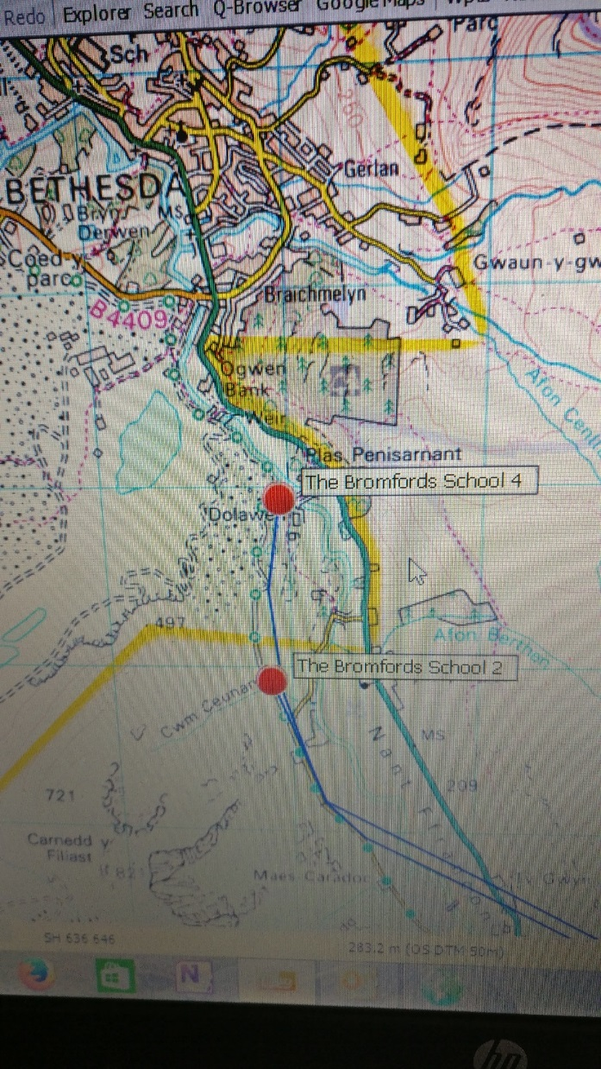
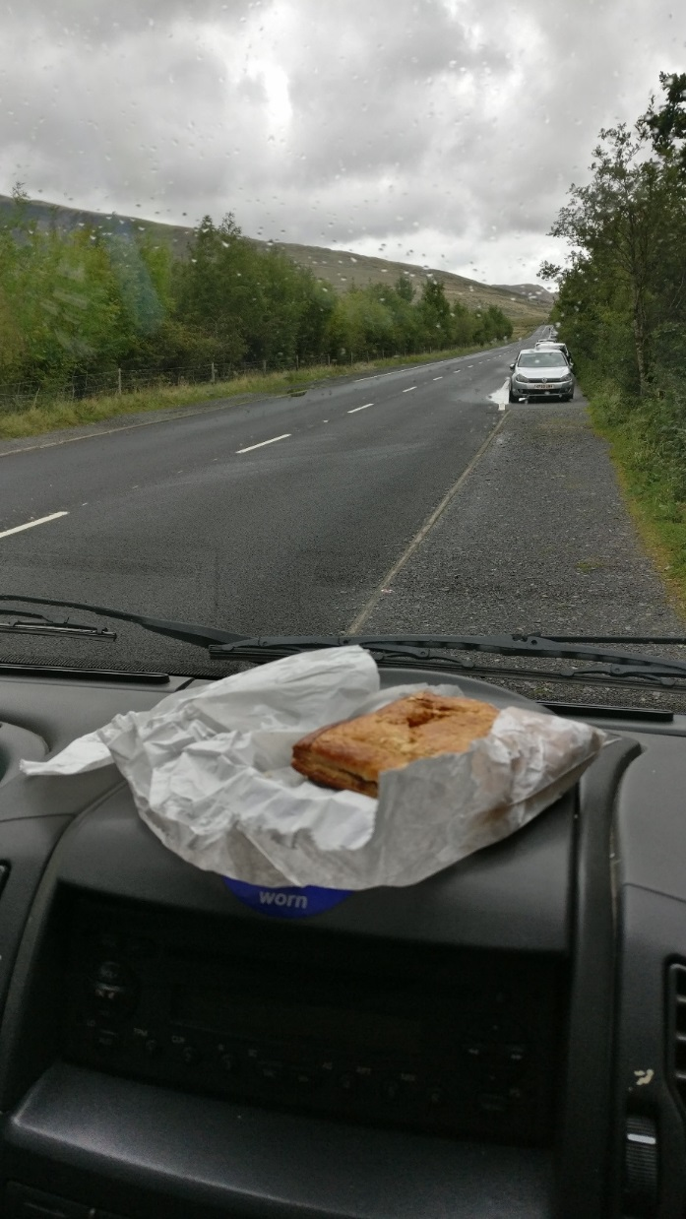
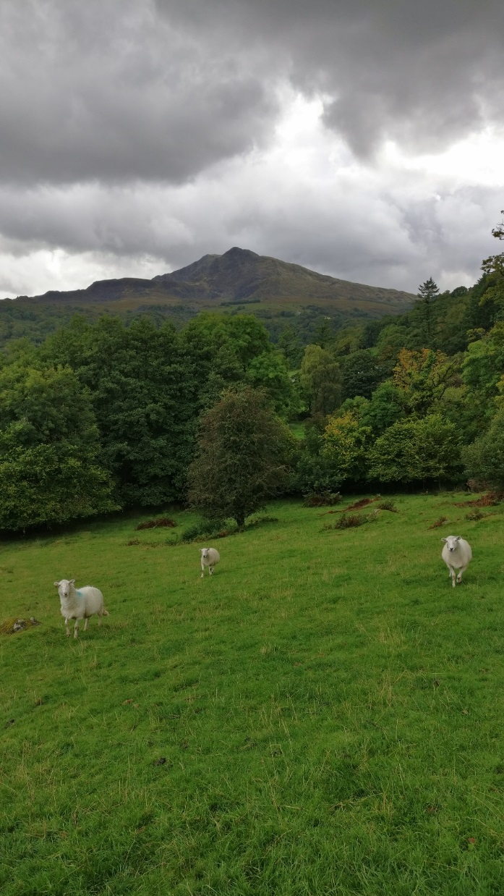
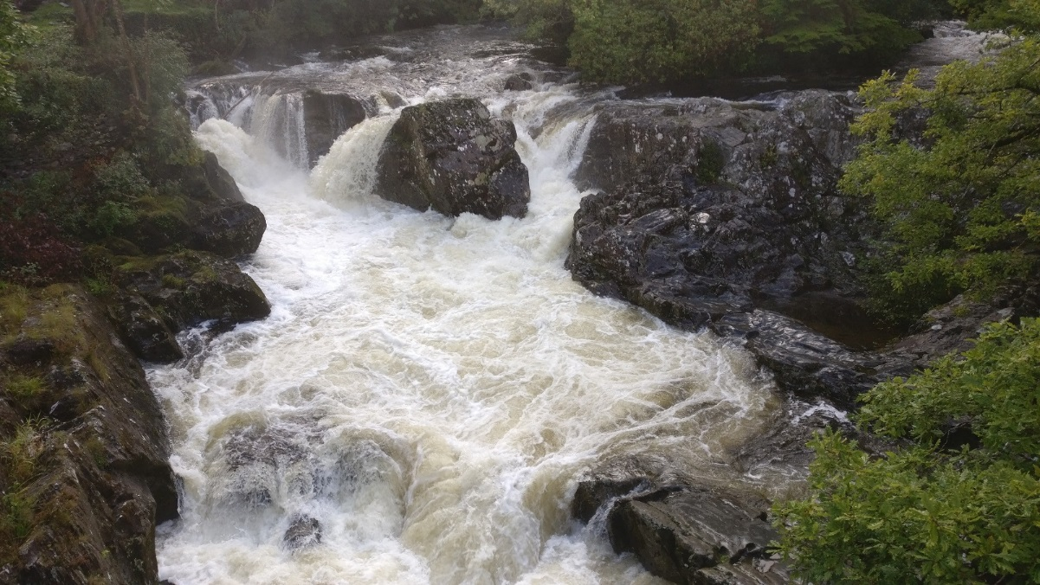
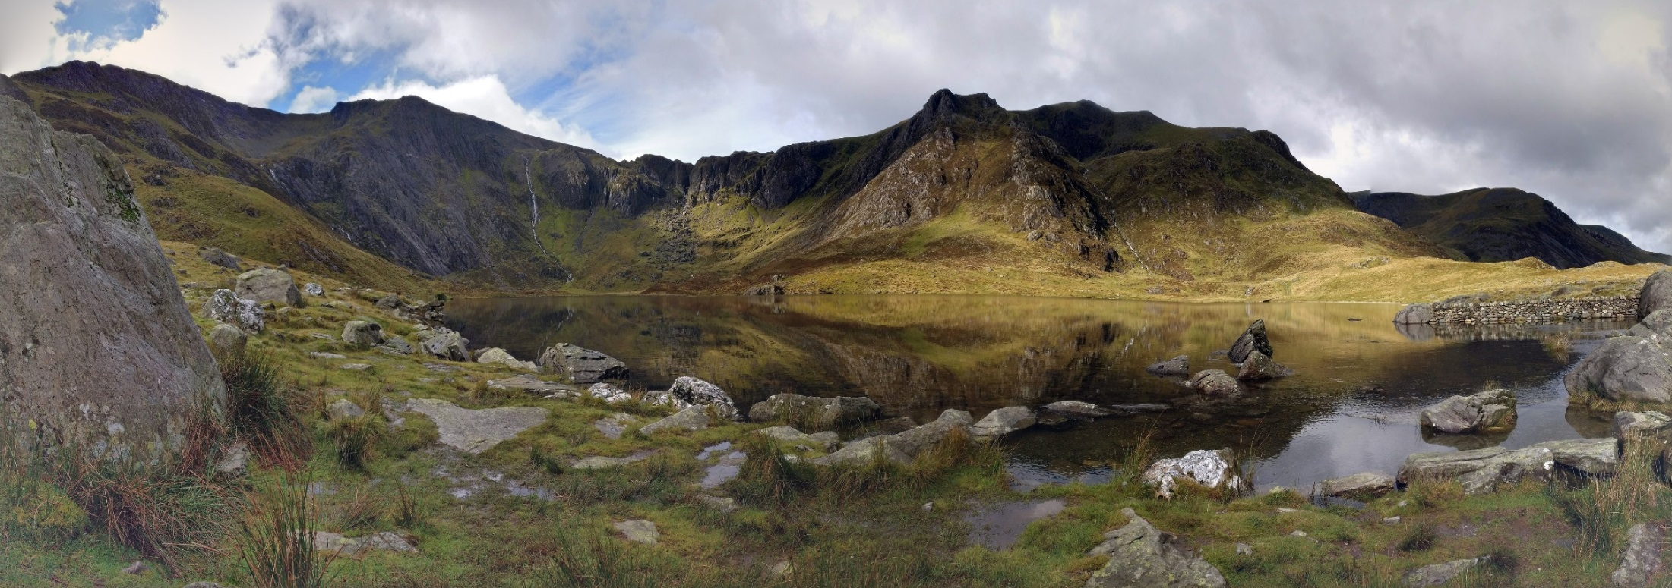
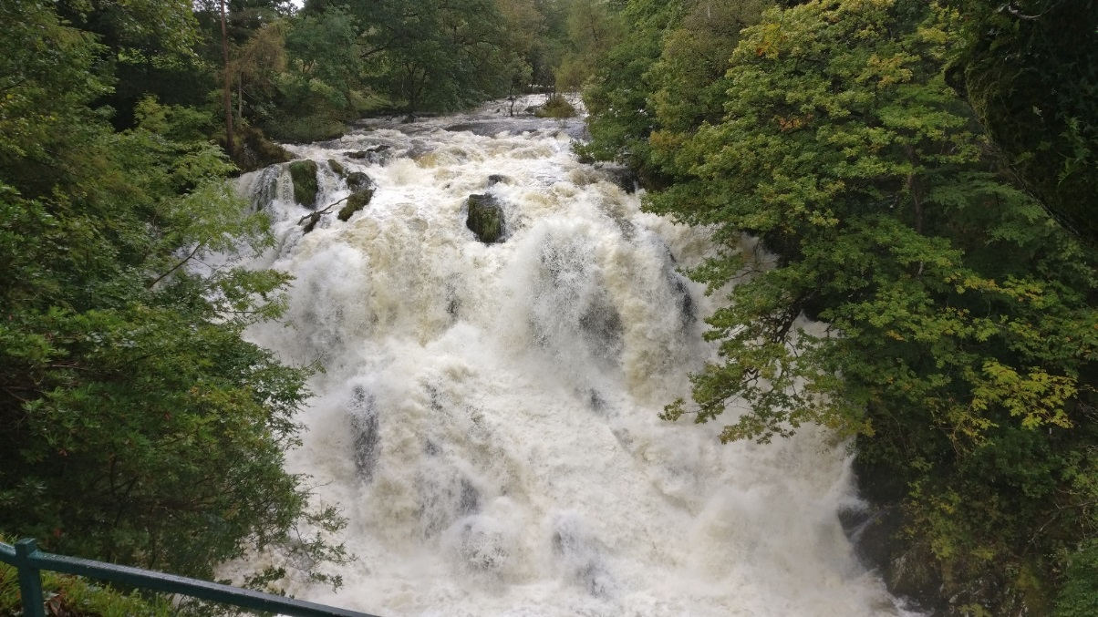
Describe this space

Slide 14
Space / Place – What is the difference?

Slide 15
Space / Place – What is the difference?
Space = unknown location?
Place = somewhere with meaning?

Slide 16
Bridging work
Over summer you should complete the Pixl Gateway Progression Booklet
Find 3 human and 3 physical geography related articles / websites / videos and explain how they link to the topics you’re studying at A Level.
Annotate the 4 photos to see how well you can identify themes from unknown resources.
Practice your essay writing skills by writing one essay from a choice of 7.

Slide 17
Final Tips
Ensure you purchase your stationery before arriving in September, (2 x lever arch files, dividers, stapler and hole punch, calculator)
File notes after EVERY lesson
Read ahead – we will tell you what chapter to read in advance

