Slide 1
Apprenticeship Preparation
Two aims to this session:
Sign up for alerts for apprenticeships with the National Apprenticeship Service.
Look at what a good CV needs.
Why is this relevant?
Includes the ability to search for degree apprenticeships.
You’ll probably need a CV to get a job at some point.

Slide 2
National Apprenticeship Service

Slide 3
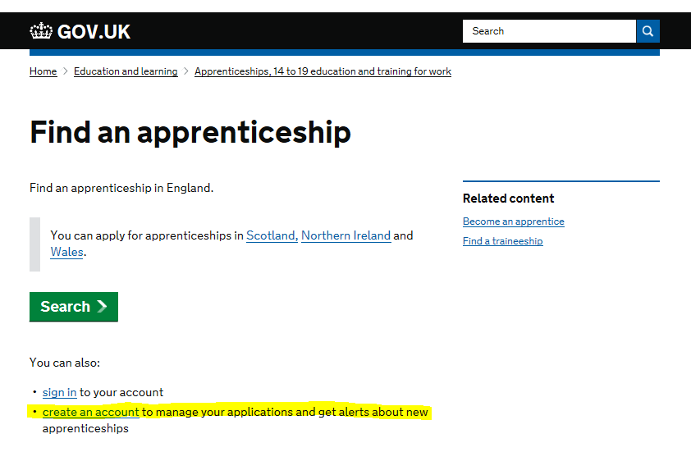

Slide 4
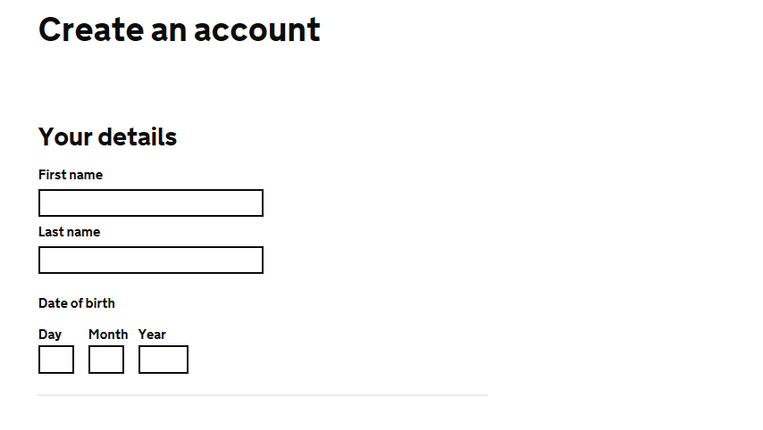
Work through the account creation details.
Use an email that you check regularly as it is needed for employers to contact you and for you to complete the sign up.

Slide 5
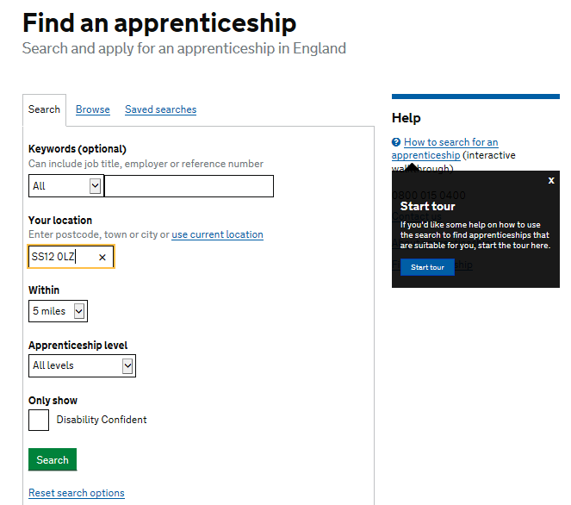
Now set your search criteria.
If there’s a particular job you want use that in the keywords.
Set your distance and level.

Slide 6
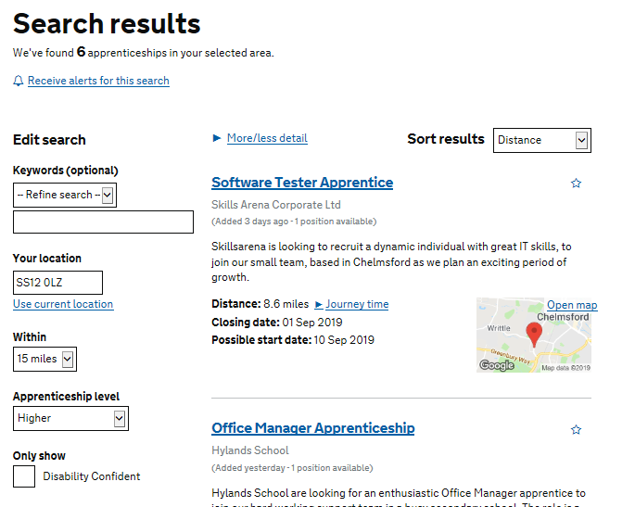
You’ll then get results like these.
If you then click on – “receive alerts for this search” whenever there is a new opportunity matching your criteria, you’ll get an email or text.
I’d suggest you have a few searches saved to cover some of the different levels of apprenticeship.

Slide 10
What goes on my CV?
Discuss ideas in groups.

Slide 16
Use this section to include relevant skills that don’t apply in your work and school experience.

Slide 17
In this section you need to relate your achievements to relevant skills that will be useful in your chosen field. E.g. Doing a charity skydive – organising fundraising events, overcoming challenges, leading a team.

Slide 26
Next Steps
Look at your CV and decide what are the strengths of it?
What needs to be removed?
What needs to be added?
Do you need to secure some relevant work experience or volunteering to support your CV?

Slide 27
Peer Support
Having spent some time working on your CV, have a look at each others.
What are the strengths of their CV?
What could be improved on their CV?

